Slide 1
EECT 101-51C Lab Notebook
ELECTRONIC PROJECTS
Fall 2014
Cody Fletcher
12-17-14

Slide 2
Table of Contents
Lab 1 – Soldering Intro 3
Lab 2 – Resistors and Ohm’s Law 8
Lab 3 – Resistors and Multisim 12
Lab 4 – Test Equipment 1 16
Lab 5 – Test Equipment 2 20
Lab 6 – Equipment Checkout of CD-1 24
Lab 7 – Equipment Checkout Cadet 2 Part 1 28
Lab 8 – Equipment Checkout Cadet 2 Part 2 32
Lab 9 – Filters 36
Lab 10 – Amplifier project 40
Lab 11 – Troubleshoot Home Electronics 44
Lab 12 – Soldering Small Kits 48
Lab 13 – Solder Project Kit 52

Slide 3
Lab 1 - Soldering

Slide 4
Lab 1 – Soldering
Objective
To gain experience soldering electronic component
Equipment and Material
Soldering Iron, Solder, Safety Goggles
Research and Information
Soldering tutorials at www.ivytechengineering.com

Slide 5
Lab 1 - Soldering
I did the flashing LEDs kit.
The completed project allows you to adjust the delay on the LEDs to make them blink faster of slower.

Slide 6
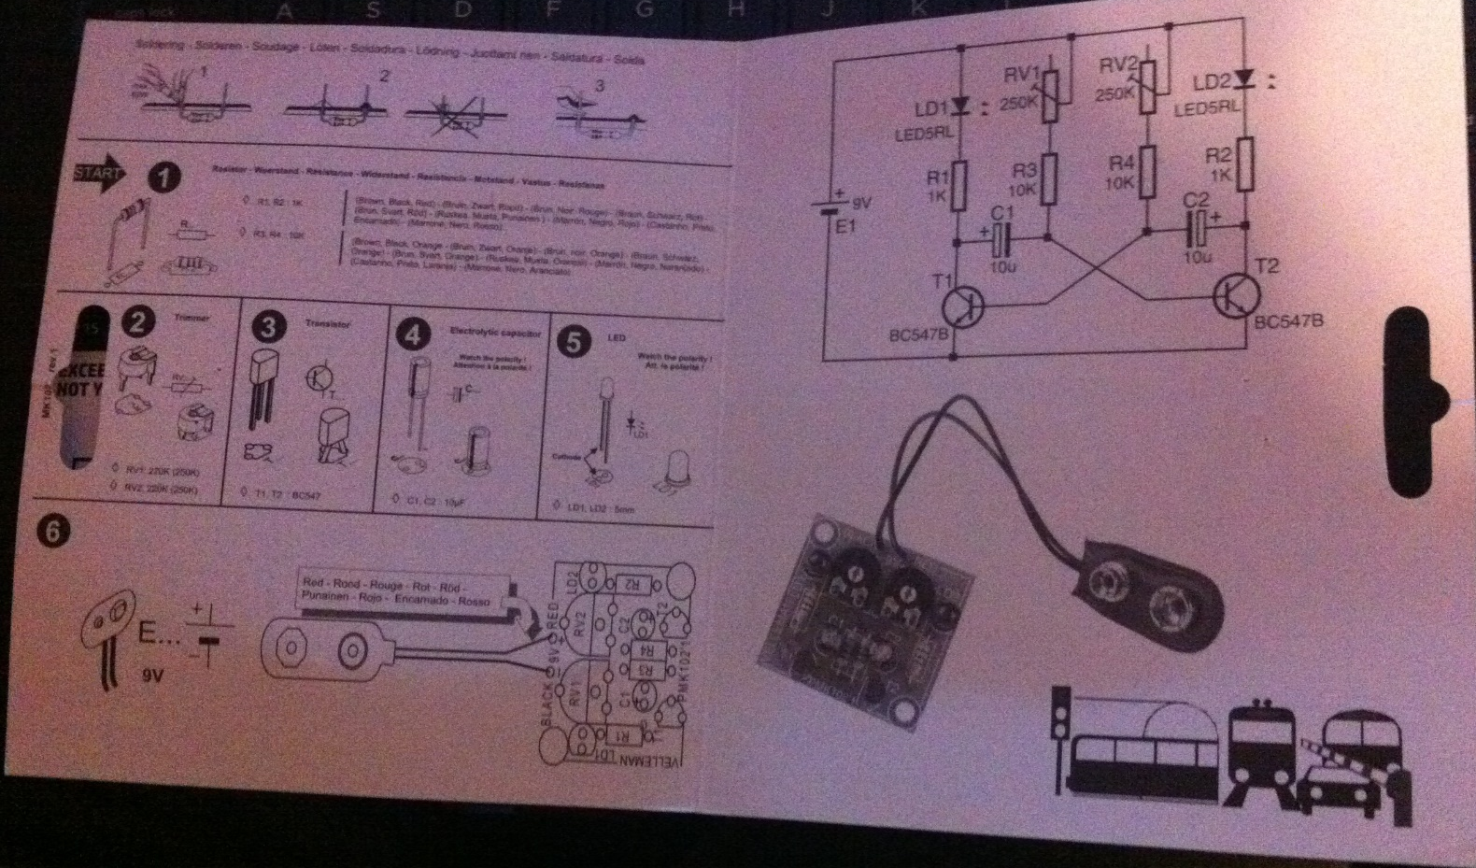
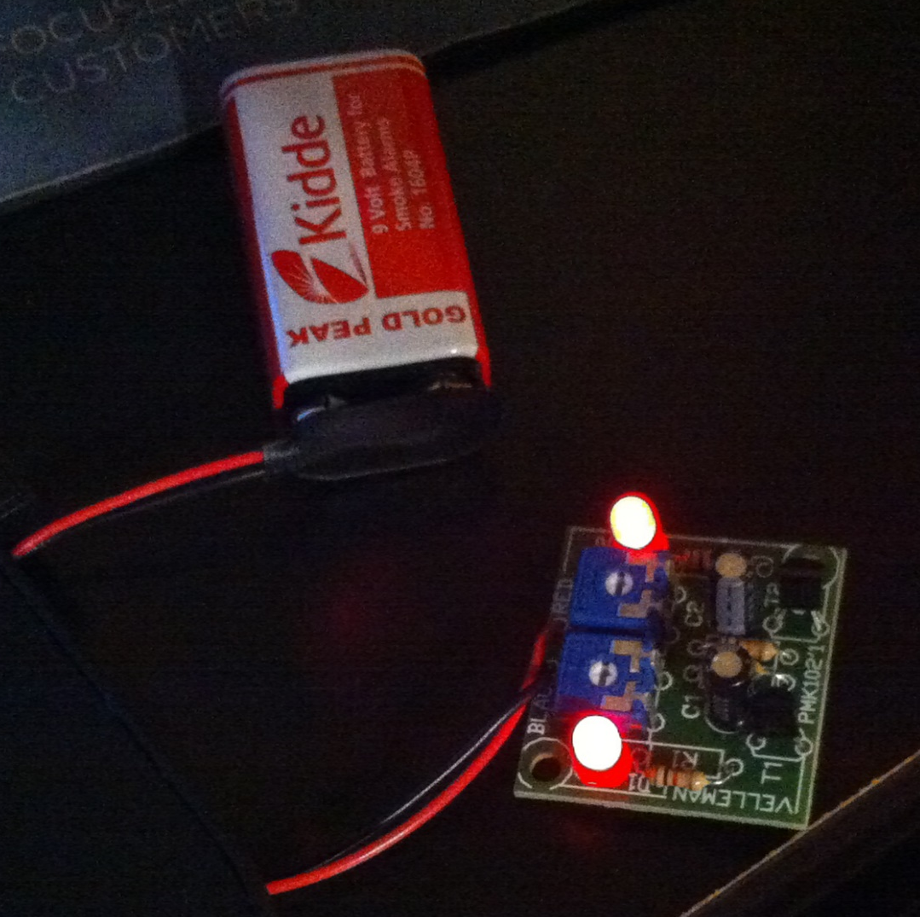

Slide 7
Lab 1 - Soldering
Summary and Conclusions
I learned that I need more practice with getting a smooth solder connection.
I also found out that it is easy to mess up and ruin the whole project if you hold the iron on to long on burn the board.

Slide 8
Lab 2
Resistors and Ohm’s Law

Slide 9
Lab 2 resistors and ohm’s law
Objective
To put resistor in a parallel and series circuit
Equipment and materials
DMM
Resistors

Slide 10
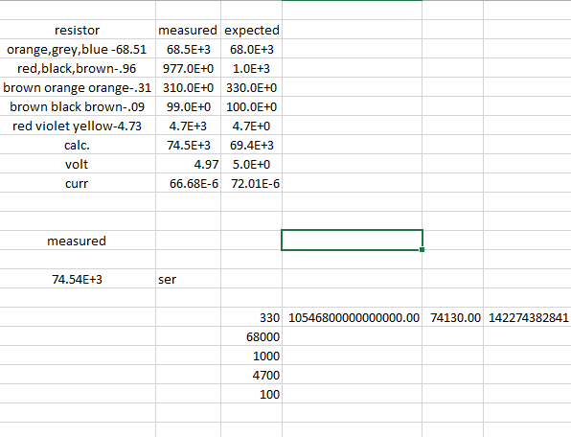
Lab 2 resistors and ohm’s law

Slide 11
Lab 3 – Resistors and Multisim

Slide 12
Lab 3 – Resistors and Multisim
Objective
To replicate the results we got in the lab
Equipment and materials
Multisim

Slide 13
Lab 4 – Test Equipment 1

Slide 14
Lab 4 – Test Equipment 1
Objective
To get a better understanding of the test equipment that we use in lab
Equipment and materials
Function Generator
Oscilloscope

Slide 15
Lab 4 – Test Equipment 1
I learned more of the features of the equipment and how to better use them for tasks

Slide 16
Lab 6 – Equipment Checkout of CD-1

Slide 17
Lab 6 – Equipment Checkout of CD-1
To test all components of the CD- 1 to figure out what components are in working order and which ones need to be replaced

Slide 18
Lab 6 – Equipment Checkout of CD-1
We ran through each component and checked the output of each to make sure we got the results needed form them
Checked missing components make a replacement list

Slide 19
Lab 6 – Equipment Checkout of CD-1
I learned that the technology has not changed that much since they where built.
The components just became smaller and faster

Slide 20
Lab 7 – Equipment Checkout Cadet 2 Part 1

Slide 21
Lab 7 – Equipment Checkout Cadet 2 Part 1
Box #1 | External Parts Needed | Switches | Led | Clock (cmos) | Clock (ttl) | Frequency measured | Fuse
 | Voltage Knob | 1 Jumps | 1 good | Knob tough to turn |  |  | 3 Ohms resistance
Serial Number | Fuse Casing Worn | 2 Good | 2 good | 1 Hz did not measure | 1 Hz Produces clock | did not measure
40503 | New Breadboard | 3 Good | 3 good | 10 HZ measured | 10 Hz Produces Clock | Frequency jumping
 | Power Cord | 4 Good | 4 good | 100 Hz Measures bad duty cycle | 100 Hz Bad duty cycle | 172.4
 |  | Left Pulsar works |  | 1KHz Measured | 1K Hz Bad Duty Cycle | 1.9k
 | Internal Parts | Right Pulsar Works |  | 10kHz Measured bad duty cycle | 10 kHz Bad Duty Cycle | 24k
 | Nothing | Right Bottom Pulsar Works |  | 100KHz Measured Bad duty cycle | 100 KHz Bad Duty Cycle | 131k
 |  | Left Bottom Pulsar Works |  | EXT.
 |  |  |  | Positive and Negative
 |  |  |  | Good Duty Cycle
 |  |  |  | Frequency Good
Box # 2
Serial Number | External Part Needed | Switches | LED | Clock(cmos) | Clock (ttl) | Frequency measured | Fuse
34527 | New Clock Knob | 1 Good | 1 Good | Knobs Loose |  |  | .24 ohms resistance
 | HWD DIL 220 LED | 2 Good | 2 Dim | 1 Hz did not work | 1 Hz did not work | Did Not measure
 | Power cord | 3 Good | 3 Good | 10 Hz works | 10 Hz bad Duty Cycle | Nothing
 | Bread Board | 4 Good | 4 Good | 100 Hz Works | 100 Hz Works | 111 Hz
 |  | Left Pulsar Top Good |  | 1 KHz Works Bad Duty Cycle | 1 KHz works | 1.4 KHz
 | Internal Parts | Right Pulsar Top Good |  | 10 KHz Works Bad Duty Cylce | 10 KHz Works | 23.8 KHz
 | New Wiper | Right Bottom Pulsar Good |  | 100 KHz Works | 100 Khz works
 | Fuse | Left Bottom Pulsar Works Bad Connection
 |  |  |  | EXT.
 |  |  |  | measures well until 10 MHz
Serial Number | External Part Needed | Switches | LED | Clock(cmos) | Clock (ttl) | Frequency measured | Fuse
38844 | New Clock Knob | 1 Good | 1 Good |  |  |  | 3.7 ohms resistance
 | HWD DIL 220 LED | 2 Good | 2 good | 1 Hz did not work | 1 Hz works | Did Not measure
 | Power cord | 3 Good | 3 Good | 10 Hz works | 10 Hz works | Did Not measure
 | Bread Board | 4 Good | 4 Good | 100 Hz Works | 100 Hz Works | 158 Hz
 |  | Left Pulsar Top Good |  | 1 KHz Works Bad Duty Cycle | 1 KHz works | 1.5 KHz
 | Internal Parts | Right Pulsar Top Good |  | 10 KHz Works Bad Duty Cylce | 10 KHz Works | 16.2 KHz
 | New Wiper | Right Bottom Pulsar Good |  | 100 KHz Works | 100 Khz works | 163 Hz
 | Fuse | Left Bottom Pulsar good
 |  |  |  | EXT.
 |  |  |  | good

Slide 22
Lab 10 –amplifier project

Slide 23
Lab 10 –amplifier project
To build a speaker using parts in the lab
Needs to be small and powered with batteries or other low voltage sources

Slide 24
Lab 10 –amplifier project
I built a speaker using a LM 386 chip
It runs off of USB power
Volume can be controlled within the circuit
Can connect to an audio source through an audio jack

Slide 25
Lab 10 –amplifier project
I learned just how powerful a simple circuit can be
I need more practice with multisim and transferring things to ultiboard
I also need work with imputing chips and components into the system on multisim

Slide 26
Lab 11 – Troubleshoot Home Electronics
To troubleshoot and repair if possible any electronics from home

Slide 27
Lab 11 – Troubleshoot Home Electronics
I brought in a surround sound box to diagnose the lack of power
I tested multiple components before the was an arc of power that blow at least 1 resistor

Slide 28
Lab 11 – Troubleshoot Home Electronics
I learned that testing equipment can be difficult and sometimes dangerous

Slide 29
Lab 12 – Soldering Small Kits
To test how much we learned about circuits and how they work
To test advancement of soldering

Slide 30
Lab 12 – Soldering Small Kits
I did a 3D Christmas tree that sits on a 9V battery
All light work and blink on and off

Slide 31
Lab 13 – Solder Project Kit
Final test of soldering
To see how advanced we became at soldering

